Slide 1

Visualization and Analysis – Tutorial Presentation for Feedback Date:
Group Id: A177 Name of Student Presenting:

Slide 2
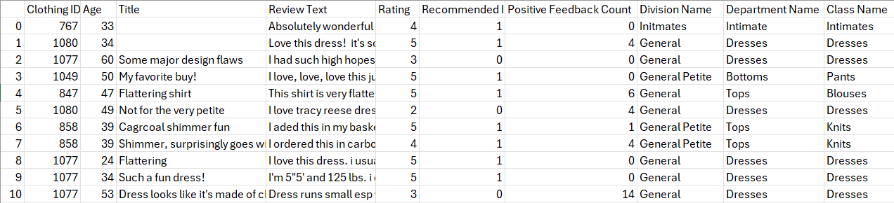
We are using the dataset DS147- Womens Clothing E-Commerce Reviews.csv to answer our Research Question “Is there a correlation between rating and age in Womens Clothing E-Commerce Reviews ”
The dataset has 23486 rows
The dependent variable is Rating
The independent variable is Age

Slide 3
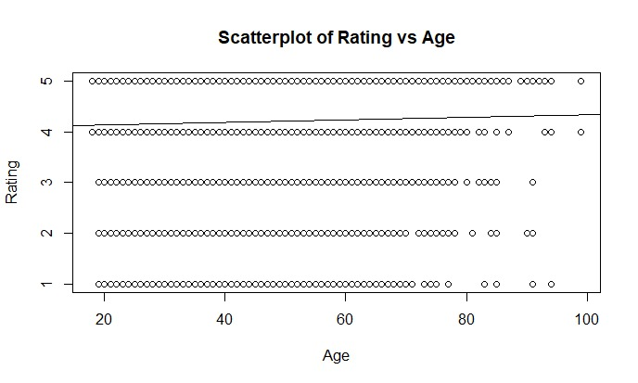
Part 1: VISUALISATION
Scatterplot

Slide 4
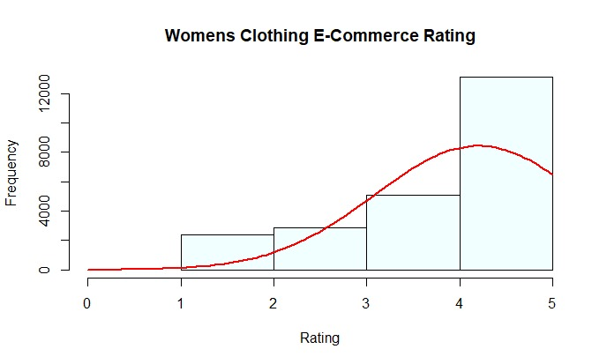
Part 1: VISUALISATION
Histogram

Slide 5
Here is a Histogram showing the frequencies of our dependent variable to include the normal curve overlay.
Our RQ asks about Correlation
:
The normal curve overlay does not follow the shape of the underlying data, so for our analysis we use the non-parametric test for correlation that does not assume normality: Spearman’s Rho
5
Notes:
5

Slide 6
Only attempt this Analysis part of the demo if you have completed your Visualization(s). Otherwise end your demo after the Visualization for feedback.
Part 2: Analysis (building on your Visualizations)

Slide 7
R Script and Results (For ALL types of test) – The Analysis
PRE 7COM1079-2022 Student Group No: ?????
7
Include a snippet of the R code you use to calculate your test statistic.
Give the value of the test statistic.
Tell us the p-value. Is it > or < 0.05?
Is the result significant?
Do you accept or reject the null hypothesis?
What does the result actually mean in the wider context of learning something useful / answering your RQ?
Notes:
7

